Slide 1
Rocket League Scrapy Project
Farouk Abdel Magied

Slide 2
What Is Rocket League?
Game Format:
Game Time: 5 mins
What happens if there is a draw?
Sudden Death – You either Win OR Lose
Existing Game Modes
1 Vs 1
2 Vs 2
3 Vs 3
4 VS 4

Slide 3
What is being scraped?
Leaderboard Page
Specific Stats Page
For each player
Scrapy was used Selenium was not needed
https://rocketleague.tracker.network/rocket-league/leaderboards/stats/all/Goals?page=1&playlist=11

Slide 4
Format of Data After Scraping Process
Data Sample Size:
Number Of Columns: 10
Number of Rows (# of players): 8,700

Slide 5
Aim of the Project
How as a professional rocket league player can I move up the ranks on the leaderboards?
Which stat(s) affects the Player Rankings the most – is it:
The number of Goals Scored
The number of Wins
The number of Assists
The number of Shots
The number of Saves
The number of Most Valuable Player (MVPs) trophies earned
Next Step: Plot all the mentioned variables against the Rankings to explore
any possible relationships

Slide 6
Plotting Variables vs. Players Rank
Covariance = -18183075
Personscorr = -0.76
Covariance = -33347183
Personscorr = -0.70
Covariance = -3787965
Personscorr = -0.40
Covariance = -8836814
Personscorr = -0.39
Covariance = -11645378
Personscorr = -0.20
Covariance = -2621597
Personscorr = -0.19
Factors that are highly correlated to the Players Rank:
Goals Scored
Shots taken
Number of Wins
We are going to dive into each of those factors individually
Covariance = -2282
Personscorr = -0.14

Slide 7
Exploring the relationship Between Goals Scored and Shots
Having more Shots will lead to more Goals which will then most importantly lead you to obtain a higher Ranking in the Leaderboards
Covariance = -57478250
Personscorr = 0.81

Slide 8
What about Winning – Increasing the Number of Wins?
OR
Should I Attack?
Should I Defend?
Covariance = 6378845
Personscorr = 0.37
Covariance = 14361362
Personscorr = 0.65
The more you defend the more you win

Slide 9
What it takes to be in the top 1%
Mean = 10,545
Mean = 29,131
Mean = 20,436
Mean = 10,419
Mean = 4,714
Mean = 60,830

Slide 10
Conclusion
How as a professional rocket league player can I move up the ranks on the leaderboards?
Score more Goals
Have a high frequency of Shots on the intended target
Don’t Ignore your defensive play, as the more Saves you have the more Wins you achieve, and the more wins you achieve the closer you move to the top of the leaderboards.
What it takes to be in the top 1%?
Goals Scored | 29,131
Wins | 10,545
Shots | 60,830
Assists | 10,419
Saves | 20,436
MVPs | 4,714
Mean values are represented

Slide 11
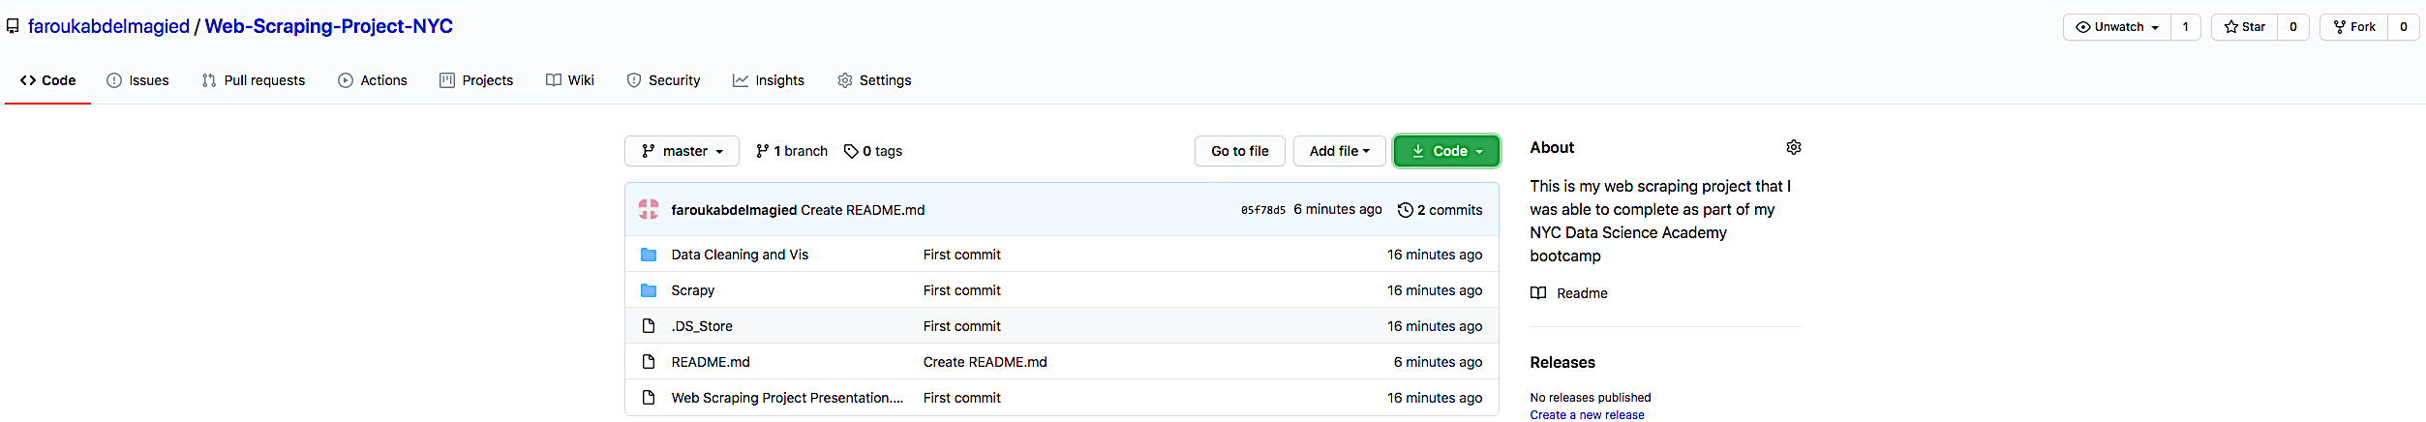
Is this on GitHub?
https://github.com/faroukabdelmagied/Web-Scraping-Project-NYC

